Slide 1
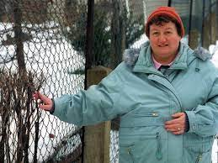
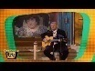
FBI
Partner
development
VIRGINIA.ibm.chair(1D8723)
187
angela(HOMCEI:CHANLEOR)
Gorbahce(seitz)
PREA
Gorahh(micheala)
0.001 1D8723(rcardor)
JFK.BULLET.SHOOTER.”PENG”
!HOMICIDE:LUX(ddr)
!HOMICIDE:IS-A-BELL(soviet union)
IMPORT visa employe.peng.?
HOMCIDE:MAYOR the linkeinheim/werder delta data
ATOMBOMB
Anglea(Max-Plank)
(delta)
Docs
(delta)
Sovietn union
ddr
gorbache)(Dr JOESPHE)
Angela(TORT1:HOMCEI:AHCNELOR:mother)
Docs
(delta)
mainstreet
SAP robhacoe(dr, maik)
SAP angale(anita, HOCMEI:CHANAO mother)

Slide 2
FBI
Partner
development
1:30 PM Fort Worth Library – Installation Web Service

